Slide 1
Chapter 2 Applications of the Derivative

Slide 2

Chapter Outline
Describing Graphs of Functions
The First- and Second-Derivative Rules
The First- and Second-Derivative Tests and Curve Sketching
Curve Sketching (Conclusion)
Optimization Problems
Further Optimization Problems
Applications of Derivatives to Business and Economics

Slide 3
§ 2.1
Describing Graphs of Functions

Slide 4
Section Outline
Increasing and Decreasing Functions
Relative and Absolute Extrema
Changing Slope
Concavity
Inflection Points
x- and y-Intercepts
Asymptotes
Describing Graphs

Slide 5
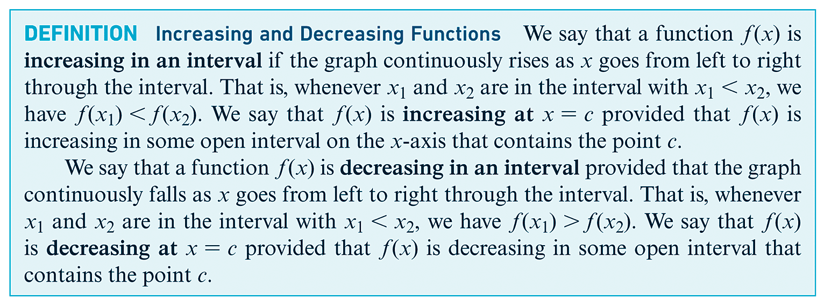
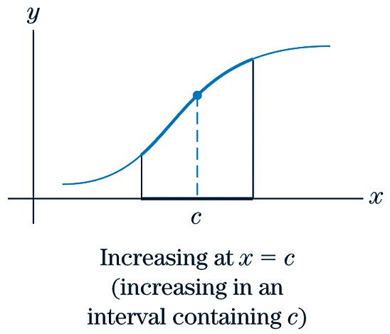
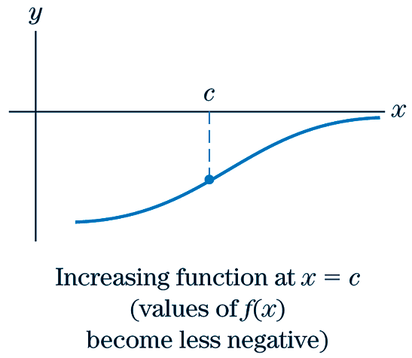
Increasing Functions

Slide 6
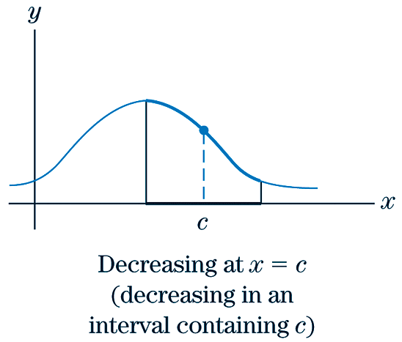
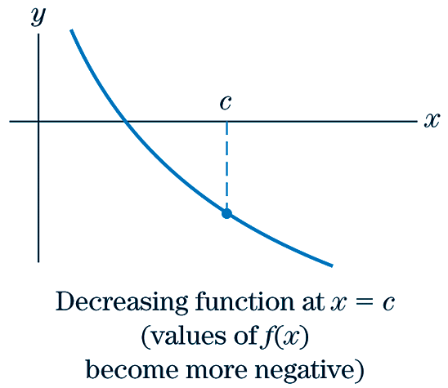
Decreasing Functions

Slide 7

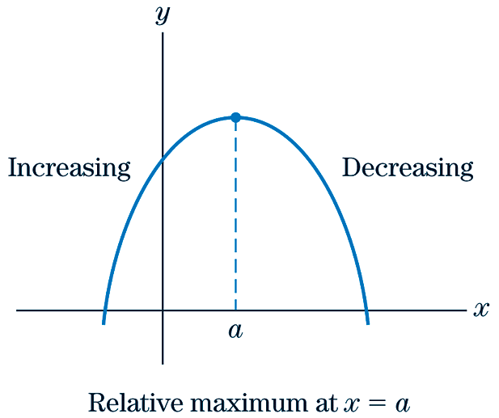
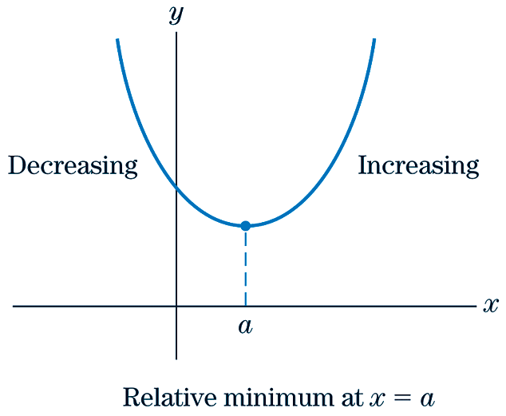
Relative Maxima & Minima

Slide 8

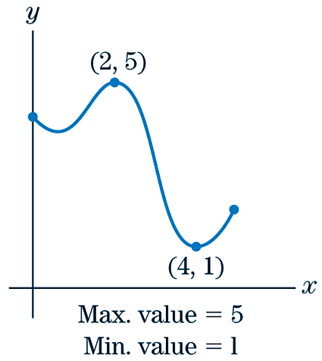
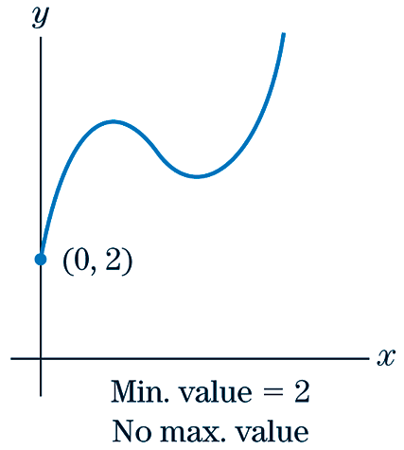
Absolute Maxima & Minima

Slide 9
Changing Slope
EXAMPLE
Draw the graph of a function y = f (T) with the stated properties.
In certain professions the average annual income has been rising at an increasing rate. Let f (T) denote the average annual income at year T for persons in one of these professions and sketch a graph that could represent f (T).
SOLUTION
Since f (T) is rising at an increasing rate, this means that the slope of the graph of f (T) will continually increase. The following is a possible example.
Notice that the slope becomes continually steeper.

Slide 10
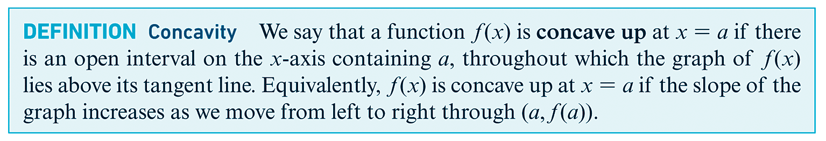
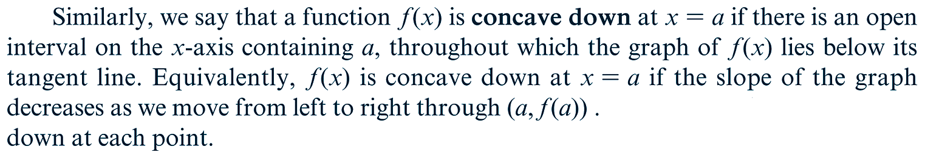
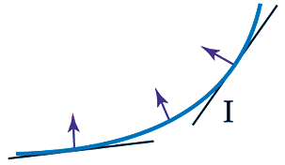
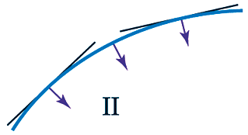
Concavity
Concave Up
Concave Down

Slide 11
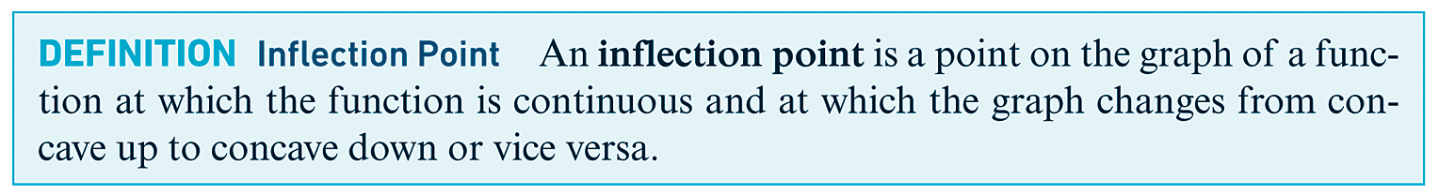
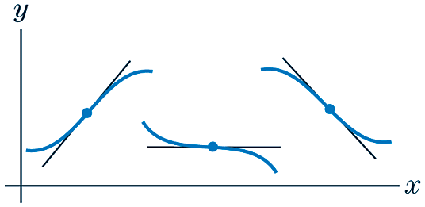
Inflection Points
Notice that an inflection point is not where a graph changes from an increasing to a decreasing slope, but where the graph changes its concavity.

Slide 12
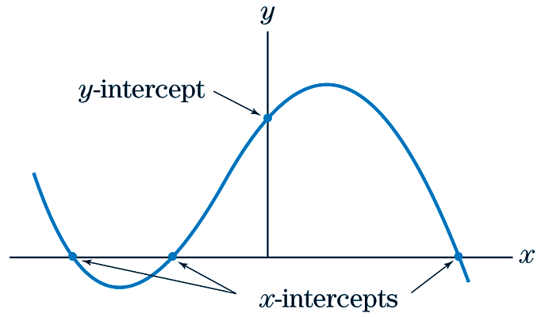
Intercepts
Definition | Definition
x-Intercept: A point at which a graph crosses the x-axis. | y-Intercept: A point at which a graph crosses the y-axis.

Slide 13
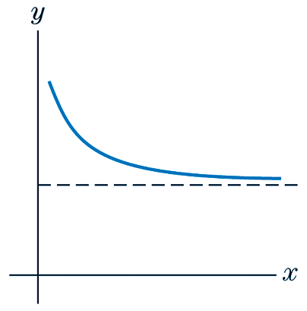
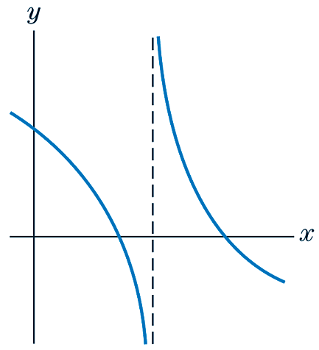
Asymptotes
Definition | Definition
Horizontal Asymptotes: A straight, horizontal line that a graph follows indefinitely as x increases without bound. | Vertical Asymptotes: A straight, vertical line that a graph follows indefinitely as y increases without bound.
Horizontal asymptotes occur when exists, in which case the asymptote is: | If a function is undefined at x = a, a vertical asymptote occurs when a denominator equals zero, in which case the asymptote is: x = a.

Slide 14
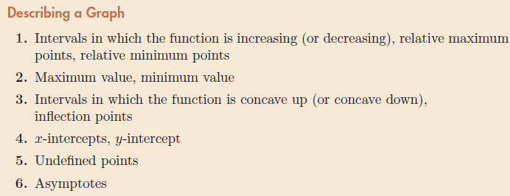
6-Point Graph Description

Slide 15
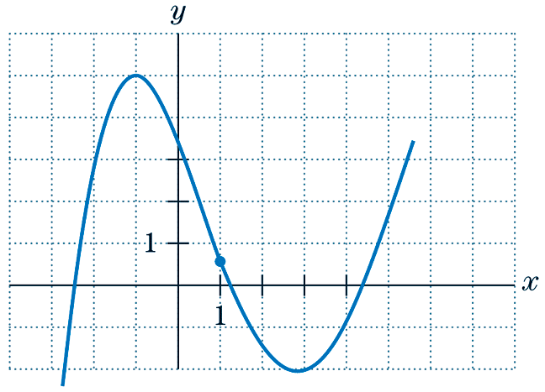
Describing Graphs
EXAMPLE
Use the 6 categories previously mentioned to describe the graph.
SOLUTION
1) The function is increasing over the intervals The function is decreasing over the intervals Relative maxima are at x = -1 and at x = 5.5. Relative minima is at x = 3 and at x = -3.

Slide 16
Describing Graphs
CONTINUED
2) The function has a (absolute) maximum value at x = -1. The function has a (absolute) minimum value at x = -3.
3) The function is concave up over the interval The function is concave down over the interval This function has exactly one inflection point, located at x =1.
4) The function has three x-intercepts, located at x = -2.5, x = 1.25, and x = 4.5. The function has one y-intercept at y = 3.5.
5) Over the function’s domain, , the function is not undefined for any value of x.
6) The function does not appear to have any asymptotes, horizontal or vertical.

Slide 17
§ 2.2
The First- and Second-Derivative Rules

Slide 18
Section Outline
First Derivative Rule
Second Derivative Rule

Slide 19
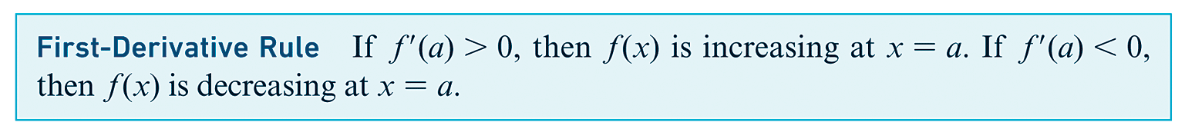
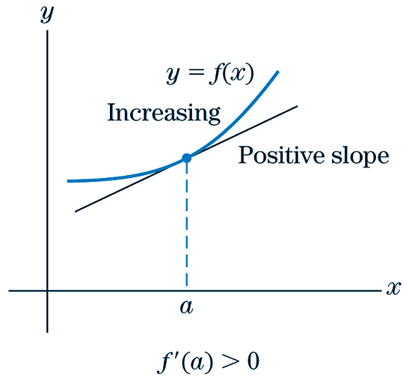
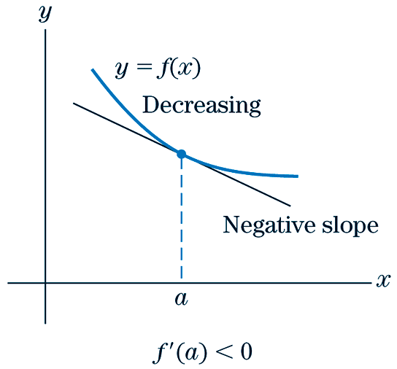
First Derivative Rule

Slide 20
First Derivative Rule
EXAMPLE
Sketch the graph of a function that has the properties described.
f (-1) = 0; for x < -1; for x > -1.
SOLUTION
The only specific point that the graph must pass through is (-1, 0). Further, we know that to the left of this point, the graph must be decreasing ( for x < -1) and to the right of this point, the graph must be increasing ( for x > -1). Lastly, the graph must have zero slope at that given point ( ).

Slide 21
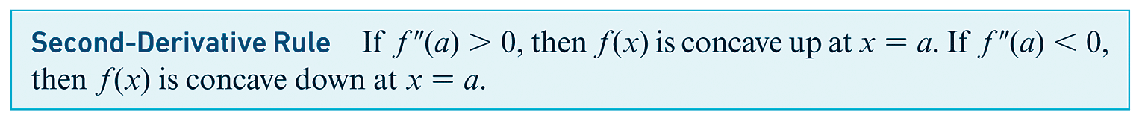
Second Derivative Rule

Slide 22
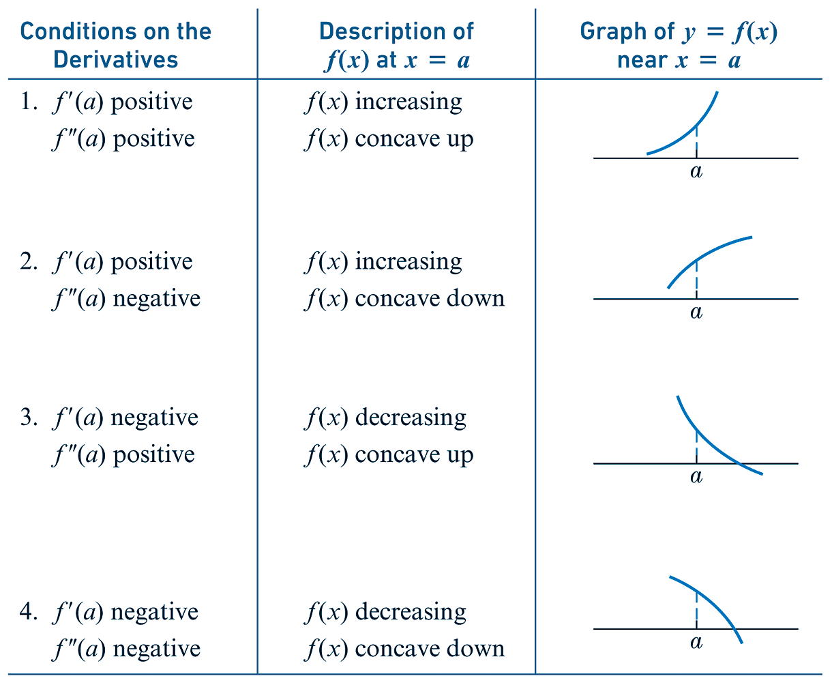
First & Second Derivative Scenarios

Slide 23
First & Second Derivative Rules
EXAMPLE
Sketch the graph of a function that has the properties described.
f (x) defined only for x ≥ 0; (0, 0) and (5, 6) are on the graph; for x ≥ 0; for x < 5, , for x > 5.
SOLUTION
The only specific points that the graph must pass through are (0, 0) and (5, 6). Further, we know that to the left of (5, 6), the graph must be concave down ( for x < 5) and to the right of this point, the graph must be concave up ( for x > 5). Also, the graph will only be defined in the first and fourth quadrants (x ≥ 0). Lastly, the graph must have positive slope everywhere that it is defined.

Slide 24
First & Second Derivative Rules
CONTINUED

Slide 25
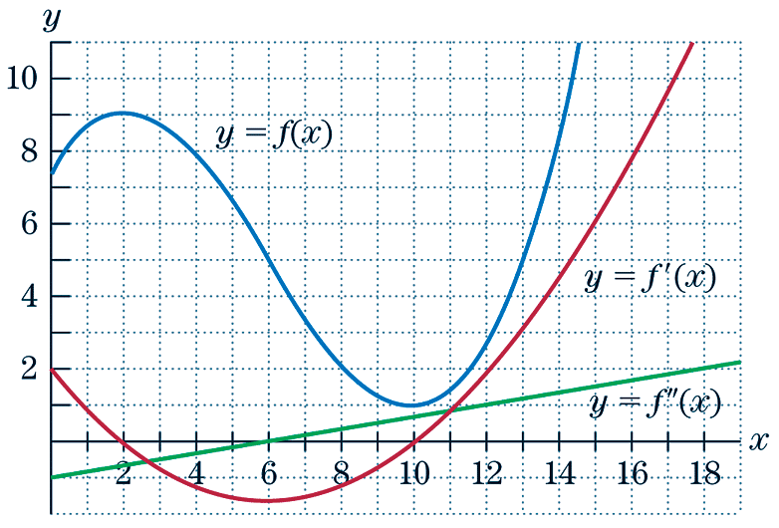
First & Second Derivative Rules
EXAMPLE
Looking at the graphs of and for x close to 10, explain why the graph of f (x) has a relative minimum at x = 10.

Slide 26
First & Second Derivative Rules
CONTINUED
SOLUTION
At x = 10 the first derivative has a value of 0. Therefore, the slope of f (x) at x = 10 is 0. This suggests that either a relative minimum or relative maximum exists on the function f (x) at x = 10. To determine which it is, we will look at the second derivative. At x = 10, the second derivative is above the x-axis, suggesting that the second derivative is positive when x = 10. Therefore, f (x) is concave up when x = 10. Since at x = 10, f (x) has slope 0 and is concave up, this means that the f (x) has a relative minimum at x = 10.

Slide 27
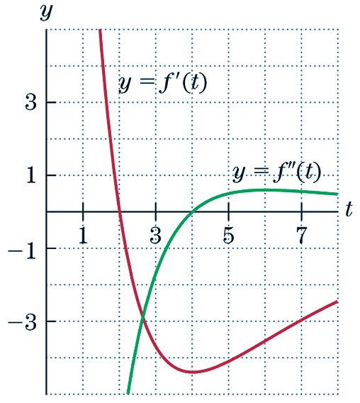
First & Second Derivative Rules
EXAMPLE
After a drug is taken orally, the amount of the drug in the bloodstream after t hours is f (t) units. The figure below shows partial graphs of the first and second derivatives of the function.

Slide 28
First & Second Derivative Rules
CONTINUED
(a) Is the amount of the drug in the bloodstream increasing or decreasing at t = 5?
(b) Is the graph of f (t) concave up or concave down at t = 5?
(c) When is the level of the drug in the bloodstream decreasing the fastest?
SOLUTION
(a) To determine whether the amount of the drug in the bloodstream is increasing or decreasing at t = 5, we will need to consider the graph of the first derivative since the first derivative of a function tells how the function is increasing or decreasing.
At t = 5 the value of the first derivative is -4. Therefore, the value of the first derivative is negative at t = 5. Therefore, the function is decreasing at t = 5.

Slide 29
First & Second Derivative Rules
CONTINUED
(b) To determine whether the graph of f (t) is concave up or concave down at t = 5, we will need to consider the graph of the second derivative at t = 5. At t = 5, the value of the second derivative is 0.5. Therefore, the value of the second derivative is positive at t = 5. Therefore, the function is concave up at t = 5.
(c) To determine when the level of the drug in the bloodstream is decreasing the fastest, we need to determine when the first derivative is the smallest. This occurs when t = 4.

Slide 30
§ 2.3
The First- and Second-Derivative Tests and Curve Sketching

Slide 31
Section Outline
Curve Sketching
Critical Values
The First Derivative Test
The Second Derivative Test
Test for Inflection Points

Slide 32
Curve Sketching
A General Approach to Curve Sketching
1) Starting with f (x), we compute
2) Next, we locate all relative maximum and relative minimum points and make a partial sketch.
3) We study the concavity of f (x) and locate all inflection points.
4) We consider other properties of the graph, such as the intercepts, and complete the sketch.

Slide 33
Critical Values
Definition | Example
Critical Values: Given a function f (x), a number a in the domain such that either or is undefined. | For the function below, notice that the slope of the function is 0 at x = -2 and the slope is undefined at x = -0.4. Also notice that the function has a relative minimum and a relative maximum at these points, respectively.

Slide 34
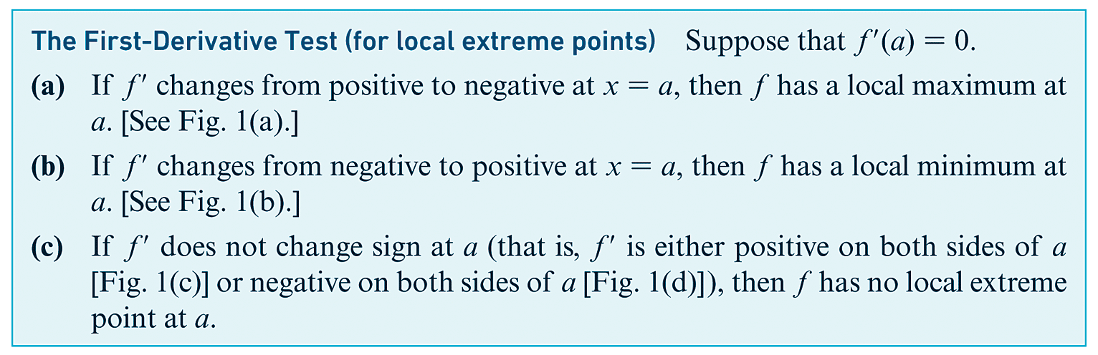
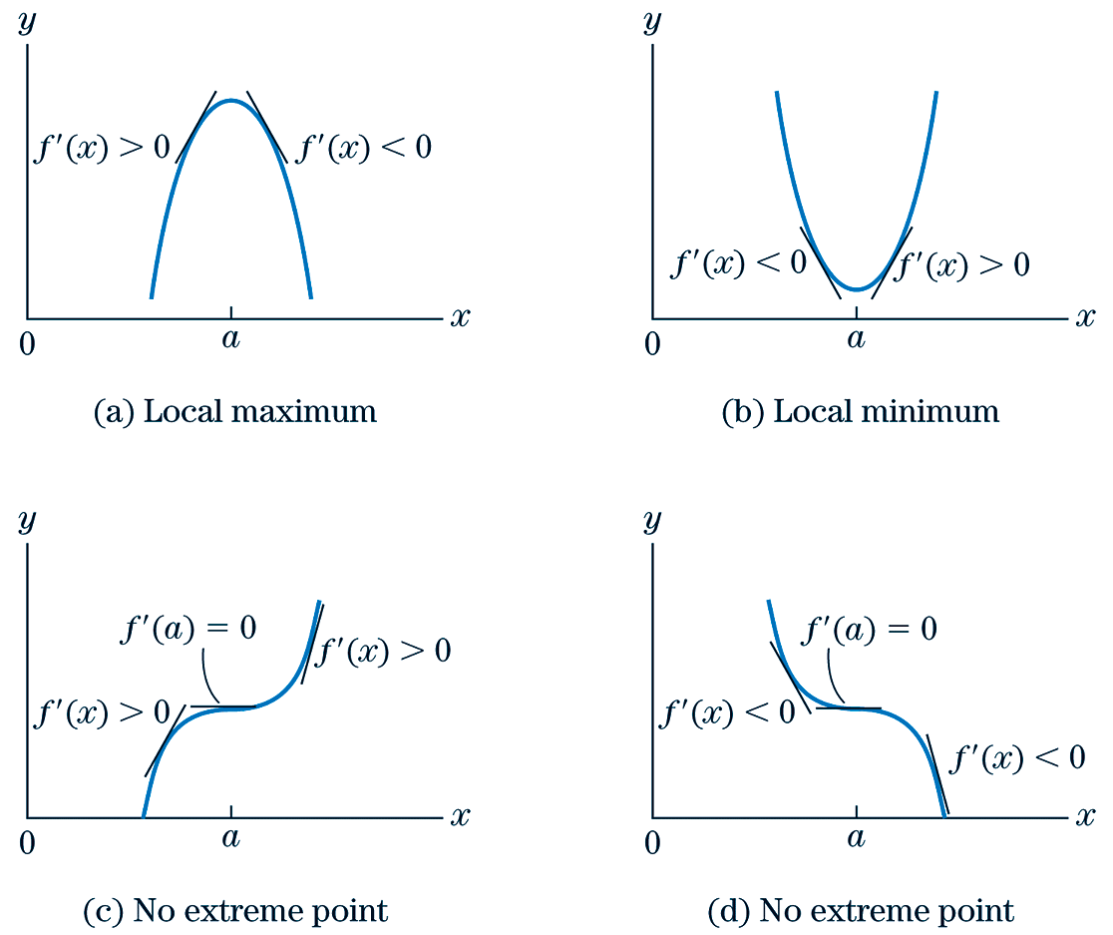
First Derivative Test

Slide 35
First Derivative Test
EXAMPLE
Find the local maximum and minimum points of
SOLUTION
First we find the critical values and critical points of f:
The first derivative if 9x – 3 = 0 or 2x + 1 = 0. Thus the critical values are
x = 1/3 and x = -1/2.
Substituting the critical values into the expression of f:

Slide 36
First Derivative Test
CONTINUED
Thus the critical points are (1/3, 43/18) and (-1/2, 33/8). To tell whether we have a relative maximum, minimum, or neither at a critical point we shall apply the first derivative test. This requires a careful study of the sign of , which can be facilitated with the aid of a chart. Here is how we can set up the chart.

Slide 37
First Derivative Test
CONTINUED
Divide the real line into intervals with the critical values as endpoints.
Since the sign of depends on the signs of its two factors 9x – 3 and 2x + 1, determine the signs of the factors of over each interval. Usually this is done by testing the sign of a factor at points selected from each interval.
In each interval, use a plus sign if the factor is positive and a minus sign if the factor is negative. Then determine the sign of over each interval by multiplying the signs of the factors and using
A plus sign of corresponds to an increasing portion of the graph f and a minus sign to a decreasing portion. Denote an increasing portion with an upward arrow and a decreasing portion with a downward arrow. The sequence of arrows should convey the general shape of the graph and, in particular, tell you whether or not your critical values correspond to extreme points.

Slide 38
First Derivative Test
CONTINUED
-1/2
1/3
Critical Points,
Intervals
x < -1/2
-1/2 < x < 1/3
x > 1/3
9x - 3
__
__
+
2x + 1
__
+
+
+
__
+
Increasing on
Decreasing on
Increasing on
Local maximum
Local minimum

Slide 39
First Derivative Test
CONTINUED
You can see from the chart that the sign of varies from positive to negative at x = -1/2. Thus, according to the first derivative test, f has a local maximum at x = -1/2. Also, the sign of varies from negative to positive at x = 1/3; and so f has a local minimum at x = 1/3. In conclusion, f has a local maximum at (-1/2, 33/8) and a local minimum at (1/3, 43/18).
NOTE: Upon the analyzing the various intervals, had any two consecutive intervals not alternated between “increasing” and “decreasing”, there would not have been a relative maximum or minimum at the value for x separating those two intervals.

Slide 40
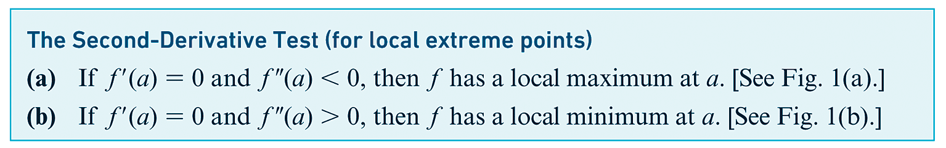
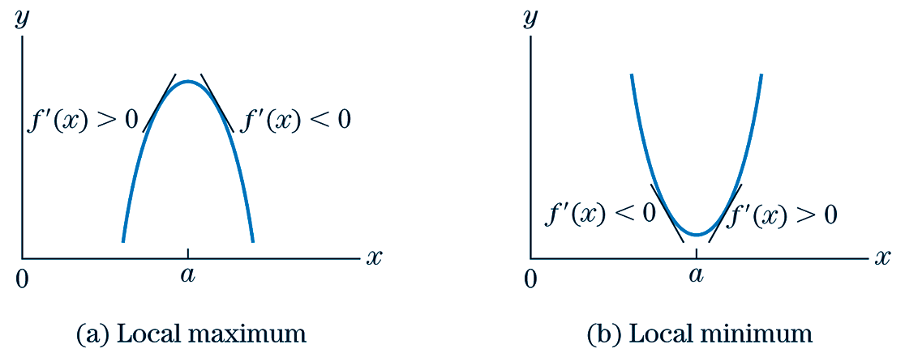
Second Derivative Test

Slide 41
Second Derivative Test
EXAMPLE
Locate all possible relative extreme points on the graph of the function
Check the concavity at these points and use this information
to sketch the graph of f (x).
SOLUTION
We have
The easiest way to find the critical values is to factor the expression for

Slide 42
Second Derivative Test
CONTINUED
From this factorization it is clear that will be zero if and only if x = -3 or x = -1. In other words, the graph will have horizontal tangent lines when x = -3 and x = -1, and no where else. To plot the points on the graph where x = -3 and x = -1, we substitute these values back into the original expression for f (x). That is, we compute
Therefore, the slope of f (x) is 0 at the points (-3, 0) and (-1, -4).
Next, we check the sign of at x = -3 and at x = -1 and apply the second derivative test:
(local maximum)
(local minimum).

Slide 43
Second Derivative Test
CONTINUED
The following is a sketch of the function.
(-3, 0)
(-1, -4)

Slide 44
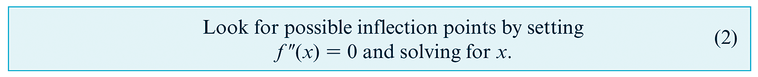
Test for Inflection Points
Locating Inflection Points:

Slide 45
Second Derivative Test
EXAMPLE
Sketch the graph of
SOLUTION
We have
We set and solve for x.
(critical values)

Slide 46
Second Derivative Test
CONTINUED
Substituting these values of x back into f (x), we find that
We now compute
(local minimum)
(local maximum).

Slide 47
Second Derivative Test
CONTINUED
Since the concavity reverses somewhere between , there
must be at least one inflection point. If we set , we find that
So the inflection point must occur at x = 0. In order to plot the inflection point, we compute
The final sketch of the graph is given below.

Slide 48
Second Derivative Test
CONTINUED
(0, 2)

Slide 49
§ 2.4
Curve Sketching (Conclusion)

Slide 50
Section Outline
The Second Derivative Test
Graphs With Asymptotes

Slide 51
Second Derivative Test
EXAMPLE
Sketch the graph of
SOLUTION
We have
We set and solve for x.
(critical value)

Slide 52
Second Derivative Test
CONTINUED
Since , we know nothing about the graph at x = 2. However, the test for inflection points suggests that we have an inflection point at x = 2. First, let’s verify that we indeed have an inflection point at x = 2. If this proves to be not the case, we would use a similar method (using the first derivative) to see if we have a relative extremum at x = 2.
We will look at the left- and right-hand limits of and see if the values of the second derivative are oppositely signed as x approaches 2.
x 6x - 12 | x 6x - 12
1.9 -0.6 | 2.1 0.6
1.99 -0.06 | 2.01 0.06
1.999 -0.006 | 2.001 0.006
1.9999 -0.0006 | 2.001 0.0006

Slide 53
Second Derivative Test
CONTINUED
From the values of in the table, we find that, as x approaches 2, the second derivative not only has a limit of 0, but the values of the function to the left of x = 2, remain negative. Also, the values of the function to the right of x = 2 remain positive. Therefore, by definition, f (x) has an inflection point at x = 2 (since the graph of f (x) is concave down to the left of x = 2 and concave up to the right of x = 2).
Notice, x = 2 was the only candidate for generating a relative extremum. Therefore, there are no relative extrema. We will now find the y-coordinate for the inflection point.
So, the only inflection point is at (2, 3).

Slide 54
Second Derivative Test
CONTINUED
Now we will look for intercepts. Let’s first look for a y-intercept by evaluating f (0).
So, we have a y-intercept at (0, -5). To find any x-intercepts, we replace f (x) with 0.
Since this equation does not factor, and the quadratic formula cannot help us either, we attempt to use the Rational Roots Theorem from algebra. In doing so we find that there are no rational roots (x-intercepts). So, if there is an x-intercept, it will be an irrational number. Below, we show some of the work employed in estimating the x-intercept.

Slide 55
Second Derivative Test
CONTINUED
x f (x)
0.54 -0.11
0.55 -0.05
0.56 0.01
0.57 0.08
Notice that the y-values corresponding to x = 0.54 and x = 0.55 are below the x-axis and the y-values corresponding to x = 0.56 and x = 0.57 are above the x-axis. Therefore, in between x = 0.55 and x = 0.56, there must be an x-intercept. For the sake of brevity, we’ll just take x = 0.56 for our x-intercept since, out of the four x-values above, it has the y-value closest to zero. Therefore, the point of our x-intercept is (0.56, 0).
Now we will sketch a graph of the function.

Slide 56
Second Derivative Test
CONTINUED
(0.56, 0)
(2, 3)
(0, 5)

Slide 57
f (x) yields information about where things are on a graph.
yields information about slope on a graph.
yields information about concavity on a graph.

Slide 58
Graphs With Asymptotes
EXAMPLE
Sketch the graph of
SOLUTION
We have
We set and solve for x.
(critical values)

Slide 59
Graphs With Asymptotes
CONTINUED
(We exclude the case x = -2 since this is outside our specified domain.) The graph has a horizontal tangent at (2, f (2)) = (2, 13). Since , the graph is concave up at x = 2 and, by the second derivative test, (2, 13) is a relative minimum. In fact, for all positive x, and therefore the graph is concave up at all points.
Before sketching the graph, notice that as x approaches zero the term 12/x in the formula for f (x) is dominant. That is, this term becomes arbitrarily large, whereas the terms 3x + 1 contribute a diminishing proportion to the function value as x approaches 0. Thus f (x) has the y-axis as an asymptote. For large values of x, the term 3x is dominant. The value of f (x) is only slightly larger than 3x since the terms 12/x + 1 has decreasing significance as x becomes arbitrarily large; that is, the graph of f (x) is slightly above the graph of y = 3x + 1. As x increases, the graph of f (x) has the line y = 3x + 1 as an asymptote.

Slide 60
Graphs With Asymptotes
CONTINUED
y = 3x + 1
(2, 13)

Slide 61
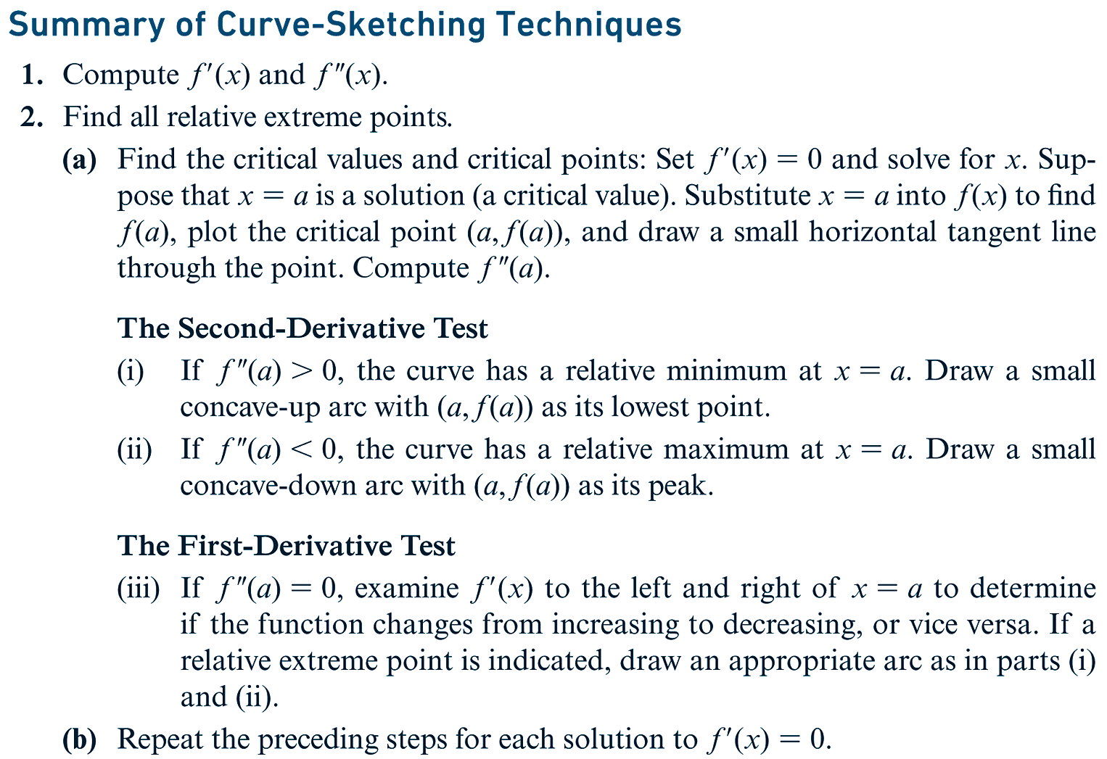
Curve Sketching Techniques
continued

Slide 62
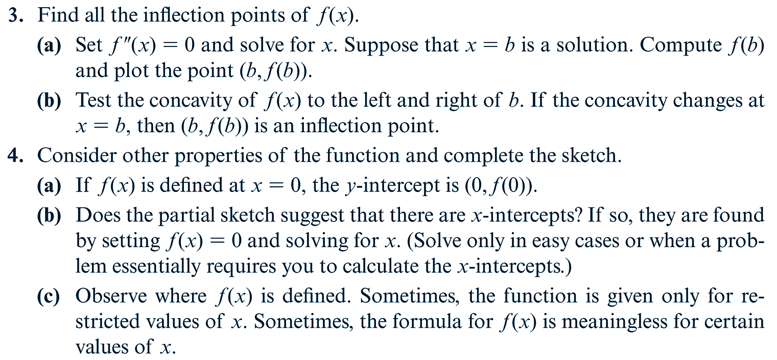
Curve Sketching Techniques (cont’d)

Slide 63
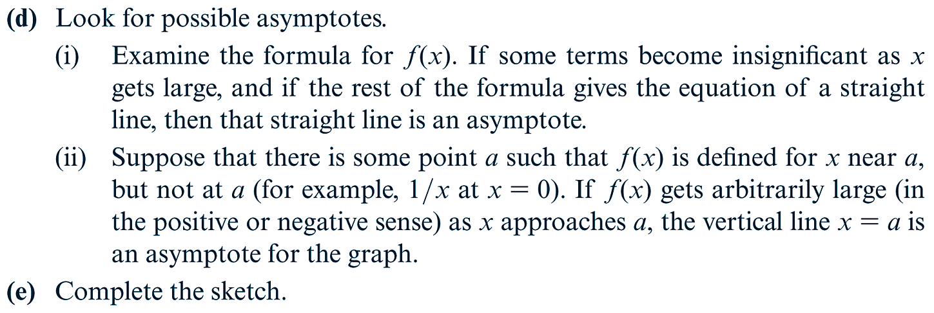
Curve Sketching Techniques (cont’d)

Slide 64
§ 2.5
Optimization Problems

Slide 65
Section Outline
Maximizing Area
Minimizing Cost
Minimizing Surface Area

Slide 66
Maximizing Area
EXAMPLE
Find the dimensions of the rectangular garden of greatest area that can be fenced off (all four sides) with 300 meters of fencing.
SOLUTION
Let’s start with what we know. The garden is to be in the shape of a rectangle. The perimeter of it is to be 300 meters. Let’s make a picture of the garden, labeling the sides.
y
x
x
y
Since we know the perimeter is 300 meters, we can now construct an equation based on the variables contained within the picture.
x + x + y + y = 2x + 2y = 300
(Constraint Equation)

Slide 67
Maximizing Area
CONTINUED
Now, the quantity we wish to maximize is area. Therefore, we will need an equation that contains a variable representing area. This is shown below.
A = xy
(Objective Equation)
Now we will rewrite the objective equation in terms of A (the variable we wish to optimize) and either x or y. We will do this, using the constraint equation. Since it doesn’t make a difference which one we select, we will select x.
2x + 2y = 300
This is the constraint equation.
2y = 300 – 2x
Subtract.
y = 150 – x
Divide.
Now we substitute 150 – x for y in the objective equation so that the objective equation will have only one independent variable.

Slide 68
Maximizing Area
CONTINUED
A = xy
This is the objective equation.
A = x(150 – x)
Replace y with 150 – x.
A = 150x – x²
Distribute.
Now we will graph the resultant function, A = 150x – x².

Slide 69
Maximizing Area
CONTINUED
Since the graph of the function is obviously a parabola, then the maximum value of A (along the vertical axis) would be found at the only value of x for which the first derivative is equal to zero.
A = 150x – x²
This is the area function.
A΄ = 150 – 2x
Differentiate.
150 – 2x = 0
Set the derivative equal to 0.
x = 75
Solve for x.
Therefore, the slope of the function equals zero when x = 75. Therefore, that is the x-value for where the function is maximized. Now we can use the constraint equation to determine y.
2x + 2y = 300
2(75) + 2y = 300
y = 75
So, the dimensions of the garden will be 75 m x 75 m.

Slide 70
Minimizing Cost
EXAMPLE
(Cost) A rectangular garden of area 75 square feet is to be surrounded on three sides by a brick wall costing $10 per foot and on one side by a fence costing $5 per foot. Find the dimensions of the garden such that the cost of materials is minimized.
SOLUTION
Below is a picture of the garden. The red side represents the side that is fenced.
y
x
x
y
The quantity that we will be minimizing is ‘cost’. Therefore, our objective equation will contain a variable representing cost, C.

Slide 71
Minimizing Cost
CONTINUED
C = (2x + y)(10) + y(5)
C = 20x + 10y + 5y
C = 20x + 15y
(Objective Equation)
Now we will determine the constraint equation. The only piece of information we have not yet used in some way is that the area is 75 square feet. Using this, we create a constraint equation as follows.
75 = xy
(Constraint Equation)
Now we rewrite the constraint equation, isolating one of the variables therein.
75 = xy
75/y = x

Slide 72
Minimizing Cost
CONTINUED
Now we rewrite the objective equation using the substitution we just acquired from the constraint equation.
C = 20x + 15y
This is the objective equation.
C = 20(75/y) + 15y
Replace x with 75/y.
C = 1500/y + 15y
Simplify.
Now we use this equation to sketch a graph of the function.

Slide 73
Minimizing Cost
CONTINUED
It appears from the graph that there is exactly one relative extremum, a relative minimum around x = 10 or x = 15. To know exactly where this relative minimum is, we need to set the first derivative equal to zero and solve (since at this point, the function will have a slope of zero).
C = 1500/y + 15y
This is the given equation.
C΄ = -1500/y² + 15
Differentiate.
-1500/y² + 15 = 0
Set the function equal to 0.
15 = 1500/y²
Add.
15y² = 1500
Multiply.
y² = 100
Divide.
y = 10
Take the positive square root of both sides (since y > 0).

Slide 74
Minimizing Cost
CONTINUED
Therefore, we know that cost will be minimized when y = 10. Now we will use the constraint equation to determine the corresponding value for x.
75 = xy
This is the constraint equation.
75 = x(10)
Replace y with 10.
7.5 = x
Solve for x.
So the dimensions that will minimize cost, are x = 7.5 ft and y = 10 ft.

Slide 75
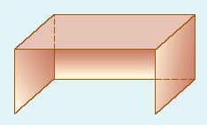
Minimizing Surface Area
EXAMPLE
(Volume) A canvas wind shelter for the beach has a back, two square sides, and a top. Find the dimensions for which the volume will be 250 cubic feet and that requires the least possible amount of canvas.
SOLUTION
Below is a picture of the wind shelter.
y
x
x
The quantity that we will be maximizing is ‘surface area’. Therefore, our objective equation will contain a variable representing surface area, A.

Slide 76
Minimizing Surface Area
CONTINUED
A = xx + xx + xy + xy
Sum of the areas of the sides
A = 2x² + 2xy
(Objective Equation)
Now we will determine the constraint equation. The only piece of information we have not yet used in some way is that the volume is 250 ft³. Using this, we create a constraint equation as follows.
250 = x²y
(Constraint Equation)
Now we rewrite the constraint equation, isolating one of the variables therein.
250 = x²y
250/x² = y

Slide 77
Minimizing Surface Area
CONTINUED
Now we rewrite the objective equation using the substitution we just acquired from the constraint equation.
A = 2x² + 2xy
This is the objective equation.
A = 2x² + 2x(250/x²)
Replace y with 250/x².
A = 2x² + 500/x
Simplify.
Now we use this equation to sketch a graph of the function.

Slide 78
Minimizing Surface Area
CONTINUED
It appears from the graph that there is exactly one relative extremum, a relative minimum around x = 5. To know exactly where this relative minimum is, we need to set the first derivative equal to zero and solve (since at this point, the function will have a slope of zero).
A = 2x² + 500/x
This is the given equation.
A΄ = 4x – 500/x²
Differentiate.
4x - 500/x² = 0
Set the function equal to 0.
4x = 500/x²
Add.
4x³ = 500
Multiply.
x³ = 125
Divide.
x = 5
Take the cube root of both sides.

Slide 79
Minimizing Surface Area
CONTINUED
Therefore, we know that surface area will be minimized when x = 5. Now we will use the constraint equation to determine the corresponding value for y.
250 = x²y
This is the constraint equation.
250 = (5)²y
Replace x with 5.
10 = y
Solve for y.
So the dimensions that will minimize surface area, are x = 5 ft and y = 10 ft.

Slide 80
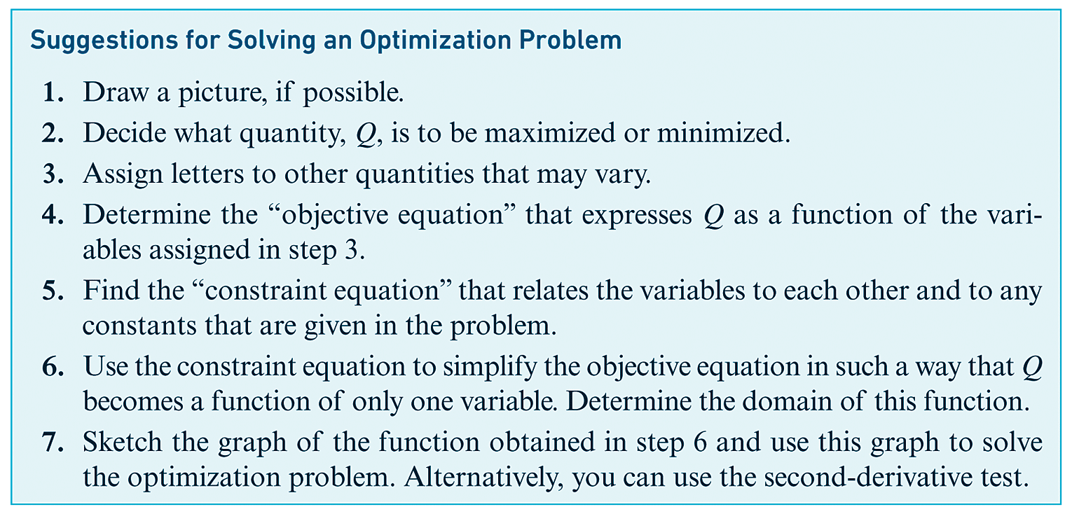
Optimization Problems

Slide 81
§ 2.6
Further Optimization Problems

Slide 82
Section Outline
Economic Order Quantity
Maximizing Revenue
Maximizing Area

Slide 83
Economic Order Quantity
EXAMPLE
(Inventory Control) A bookstore is attempting to determine the economic order quantity (EOQ) for a popular book. The store sells 8000 copies of this book a year. The store figures that it costs $40 to process each new order for books. The carrying cost (due primarily to interest payments) is $2 per book, to be figured on the maximum inventory during an order-reorder period. How many times a year should orders be placed?
SOLUTION
The quantity that we will be minimizing is ‘cost’. Therefore, our objective equation will contain a variable representing cost, C.
Let x be the order quantity and let r be the number of orders placed throughout the year.
[inventory cost] = [ordering cost] + [carrying cost]
C = 40r + 2x
(Objective Equation)

Slide 84
Economic Order Quantity
CONTINUED
Now we will determine the constraint equation. The only piece of information we have not yet used in some way is that the total number of books that will be ordered for the year is 8000. Using this, we create a constraint equation as follows.
8000 = rx
(Constraint Equation)
Now we rewrite the constraint equation, isolating one of the variables therein.
8000 = rx
8000/x = r
Now we rewrite the objective equation using the substitution we just acquired from the constraint equation.
C = 40r + 2x
This is the objective equation.
C = 40(8000/x) + 2x
Replace r with 8000/x.
C = 320,000/x + 2x
Simplify.

Slide 85
Economic Order Quantity
CONTINUED
Now we use this equation to sketch a graph of the function.

Slide 86
Economic Order Quantity
CONTINUED
It appears from the graph that there is exactly one relative extremum, a relative minimum around x = 400. To know exactly where this relative minimum is, we need to set the first derivative equal to zero and solve (since at this point, the function will have a slope of zero).
C = 320,000/x + 2x
This is the given equation.
C΄ = -320,000/x² + 2
Differentiate.
-320,000/x² + 2 = 0
Set the function equal to 0.
2 = 320,000/x²
Add.
2x² = 320,000
Multiply.
x² = 160,000
Divide.
x = 400
Take the positive square root of both sides.

Slide 87
Economic Order Quantity
CONTINUED
Therefore, we know that cost will be minimized when x = 400. Now we will use the constraint equation to determine the corresponding value for r.
8000 = rx
This is the constraint equation.
8000 = r(400)
Replace x with 400.
20 = r
Solve for r.
So the values that will minimize cost, are x = 400 books per order and r = 20 shipments of books per year.

Slide 88
Maximizing Revenue
EXAMPLE
(Revenue) Shakespear’s Pizza sells 1000 large Vegi Pizzas per week for $18 a pizza. When the owner offers a $5 discount, the weekly sales increase to 1500.
(a) Assume a linear relation between the weekly sales A(x) and the discount x. Find A(x).
(b) Find the value of x that maximizes the weekly revenue. [Hint: Revenue = A(x)·(Price).]
SOLUTION
(a) Since A(x) represents the number of weekly sales and x represents the discount, the formula for A(x) will be determined doing the following.
First, we notice that as x increases, so does A(x). Also, we notice that the basic number of weekly sales is 1000 and that when the discount increases to $5, the number of sales increases to 500. Therefore, the desired function is
A(x) = 1000 + 100x.

Slide 89
Maximizing Revenue
CONTINUED
(b) To find the value of x that maximizes the weekly revenue, we must first determine a function for revenue. This is the following.
Revenue = A(x)·(Price)
R = (1000 + 100x)·P
(Objective Equation)
Now we will determine the constraint equation. The only piece of information we have not yet used in some way is that the nondiscounted price of the pizzas is $18. Using this, we create a constraint equation as follows.
P = 18 - x
(Constraint Equation)
Now we rewrite the objective equation using the substitution we just acquired from the constraint equation.
R = (1000 + 100x)·P
This is the objective equation.

Slide 90
Maximizing Revenue
CONTINUED
R = (1000 + 100x)·(18 – x)
Replace P with 18 - x.
R = -100x² +800x + 18,000
Simplify.
Now we use this equation to sketch a graph of the function. Since x and R cannot be negative, we only use the first quadrant.

Slide 91
Maximizing Revenue
CONTINUED
It appears from the graph that there is exactly one relative extremum, a relative maximum around x = 5. To know exactly where this relative maximum is, we need to set the first derivative equal to zero and solve (since at this point, the function will have a slope of zero).
R = -100x² +800x + 18,000
This is the given equation.
R΄ = -200x + 800
Differentiate.
-200x + 800 = 0
Set the function equal to 0.
800 = 200x
Add.
4 = x
Divide.
Therefore, we know that revenue will be maximized when x = 4. That is, revenue will be maximized via a $4 discount, yielding a weekly revenue of $19,600.

Slide 92

Maximizing Area
EXAMPLE
(Area) An athletic field consists of a rectangular region with a semicircular region at each end. The perimeter will be used for a 440-yard track. Find the value of x for which the area of the rectangular region is as large as possible.
SOLUTION
The quantity that we will be maximizing is ‘area’, namely the area of the rectangular region. Therefore, our objective equation will contain a variable representing area, A.
A = xh
(Objective Equation)

Slide 93
Maximizing Area
CONTINUED
Now we will determine the constraint equation. The only piece of information we have not yet used in some way is that the perimeter of the track is 440 yards. Using this, we create a constraint equation as follows.
[distance around track] = [lengths of sides of rectangle] + [lengths of semicircles]
Before we simplify this equation, it is worth noticing that the “lengths of the semicircles” is simply a pair of semicircles that when put together would form a complete circle. Therefore, this quantity would be the circumference of a circle, the formula for which is C = πd, such that d is the diamter.
440 = [h + h] + [πd]
440 = 2h + πx
(Constraint Equation)
Now we rewrite the constraint equation, isolating one of the variables therein.
440 = 2h + πx
220 – πx/2 = h

Slide 94
Maximizing Area
CONTINUED
Now we rewrite the objective equation using the substitution we just acquired from the constraint equation.
A = xh
This is the objective equation.
A = x(220 – πx/2)
Replace h with 220 – πx/2.
A = 220x – πx²/2
Simplify.
Now we use this equation to sketch a graph of the function.

Slide 95
Maximizing Area
CONTINUED
It appears from the graph that there is exactly one relative extremum, a relative maximum around x = 75. To know exactly where this relative maximum is, we need to set the first derivative equal to zero and solve (since at this point, the function will have a slope of zero).
A = 220x – πx²/2
This is the given equation.
A΄ = 220 – πx
Differentiate.
220 - πx = 0
Set the function equal to 0.
-πx = -220
Add.
x = 220/π ≈ 70
Divide.
Therefore, we know that the area of the rectangular region will be maximized when x = 70 yards.

Slide 96
§ 2.7
Applications of Derivatives to Business and Economics

Slide 97
Section Outline
Cost, Revenue and Profit
Demand and Revenue
Taxes, Profit and Revenue

Slide 98
Cost, Revenue & Profit
EXAMPLE
(Cost and Profit) A one-product firm estimates that its daily total cost function (in suitable units) is C(x) = x³ – 6x² + 13x + 15 and its total revenue function is R(x) = 28x. Find the value of x that maximizes the daily profit.
SOLUTION
To find the value of x that maximizes the daily profit, we must first have a profit function. Since P(x) = R(x) – C(x)
P(x) = 28x – (x³ – 6x² + 13x + 15)
P(x) = – x³ + 6x² + 15x – 15.
So, the value of x which we are seeking, will be the one that corresponds to the highest point on the P(x) graph for x ≥ 0. Upon looking at the graph on the next page, it would appear that this occurs at about x = 5.

Slide 99
Cost, Revenue & Profit
CONTINUED
To determine the exact value of x for which P(x) is maximized, we must find the value of x for which P΄(x) = 0.

Slide 100
Cost, Revenue & Profit
CONTINUED
P(x) = – x³ + 6x² + 15x – 15
This is the profit function.
P΄(x) = –3x² + 12x + 15
Differentiate.
–3x² + 12x + 15 = 0
Set this equation equal to 0.
(–3x – 3)(x – 5) = 0
Factor.
x = -1, 5
Solve for x.
Therefore, profit is maximized when x = -1 or x = 5. Since x = -1 is not in the domain of P(x), the solution is x = 5.

Slide 101
Demand & Revenue
EXAMPLE
(Demand and Revenue) A swimming club offers memberships at the rate of $200, provided that a minimum of 100 people join. For each member in excess of 100, the membership fee will be reduced $1 per person (for each member). At most 160 memberships will be sold. How many memberships should the club try to sell in order to maximize its revenue?
SOLUTION
We are trying to find the value of x that maximizes revenue. We must first have a revenue function. In order to do this, we must first create a demand equation, p = f (x).
Since we are guaranteed that at least 100 memberships will be sold, we do not have to worry about situations involving x < 100. Further, for each membership that is sold, the price of a membership falls by $1. In other words, as x increases 1 unit, y decreases 1 unit.

Slide 102
Demand & Revenue
CONTINUED
Now, because of this continual reduction of price (up to 160 memberships), we know that when x = 100 memberships, the price p = $200 each. We also know that when x = 100 + 60 = 160 memberships, the price p = $200 - $60 = $140. Thus, we have two points corresponding to the demand equation: (100, 200) and (160, 140). Using these two points, we can determine the slope of the demand equation.
We can now use the point-slope form of a line to find the demand equation.
This is the point-slope form a line.
m = -1, x₁ = 100, and y₁ = 200.
Simplify.

Slide 103
Demand & Revenue
CONTINUED
Now that we have the demand equation, f (x) = -x + 300, we can determine the revenue function by using R(x) = x·p = x·f (x).
Now we will differentiate the revenue function and determine for what value(s) R΄(x) = 0.
This is the revenue function.
Differentiate.
Set this equation equal to 0.
Solve for x.
Therefore, revenue is maximized when x = 150. This is “verified” in the graph on the next page.

Slide 104
Demand & Revenue
CONTINUED

Slide 105
Taxes, Profit, and Revenue
EXAMPLE
(Taxes, Profit, and Revenue) The demand equation for a monopolist is p = 200 – 3x, and the cost function is C(x) = 75 + 80x – x², 0 ≤ x ≤ 40.
(a) Determine the value of x and the corresponding price that maximize the profit.
(b) Suppose that the government imposes a tax on the monopolist of $4 per unit quantity produced. Determine the new price that maximizes the profit.
SOLUTION
(a) We first determine the profit function, given by
P(x) = R(x) - C(x)
P(x) = xp - C(x)
P(x) = x(200 – 3x) – (75 + 80x – x²)
P(x) = -2x² + 120x - 75.

Slide 106
Taxes, Profit, and Revenue
CONTINUED
We can now differentiate P(x) and then find the value of x for which P is maximized.
This is the profit function.
Differentiate.
Set this equation equal to 0.
Solve for x.
Therefore, profit is maximized when x = 30. Now we will determine the corresponding price per unit. To do this, we will evaluate the demand equation p at x = 30.
p(x) = 200 – 3x
p(30) = 200 – 3(30) = 110
So the price per unit that maximizes profit is $110 per unit.

Slide 107
Taxes, Profit, and Revenue
CONTINUED
(b) For each unit sold, the manufacturer will have to pay $4 to the government. in other words, 4x dollars are added to the cost of producing and selling x units. The cost function is now
Now we will repeat the process we have already done, relative to our new cost function. The profit function is determined as follows.
P(x) = R(x) - C(x)
P(x) = xp - C(x)
P(x) = x(200 – 3x) – (75 + 84x – x²)
P(x) = -2x² + 116x - 75.

Slide 108
Taxes, Profit, and Revenue
CONTINUED
We can now differentiate P(x) and then find the value of x for which P is maximized.
This is the profit function.
Differentiate.
Set this equation equal to 0.
Solve for x.
Therefore, profit is maximized when x = 29. Now we will determine the corresponding price per unit. To do this, we will evaluate the demand equation p at x = 29.
p(x) = 200 – 3x
p(29) = 200 – 3(29) = 113
So the price per unit that maximizes profit is $113 per unit.

