Slide 1
Chapter 3 Techniques of Differentiation

Slide 2

Chapter Outline
The Product and Quotient Rules
The Chain Rule and the General Power Rule
Implicit Differentiation and Related Rates

Slide 3
§ 3.1
The Product and Quotient Rules

Slide 4
Section Outline
The Product Rule
The Quotient Rule
Rate of Change

Slide 5
The Product Rule
Product Rule:
The derivative of the product of two functions is the first function times the derivative of the second plus the second function times the derivative of the first. At the end of this section, we show why this statement is true.

Slide 6
The Product Rule
EXAMPLE
Differentiate the function.
SOLUTION
Let and . Then, using the product rule, and the general power rule to compute h΄(x).

Slide 7
The Quotient Rule
Quotient Rule:
(We must be careful to remember the order of the terms in this formula because of the minus sign in the numerator.)

Slide 8
The Quotient Rule
EXAMPLE
Differentiate.
SOLUTION
Let and . Then, using the quotient rule
Now simplify.

Slide 9
The Quotient Rule
CONTINUED
Now let’s differentiate again, but first simplify the expression.
Now we can differentiate the function in its new form.
Notice that the same answer was acquired both ways.

Slide 10
Rate of Change
EXAMPLE
(Rate of Change) The width of a rectangle is increasing at a rate of 3 inches per second and its length is increasing at the rate of 4 inches per second. At what rate is the area of the rectangle increasing when its width is 5 inches and its length is 6 inches? [Hint: Let W(t) and L(t) be the widths and lengths, respectively, at time t.]
SOLUTION
Since we are looking for the rate at which the area of the rectangle is changing, we will need to evaluate the derivative of an area function, A(x) for those given values (and to simplify, let’s say that this is happening at time t = t₀). Thus
This is the area function.
Differentiate using the product rule.

Slide 11
Rate of Change
CONTINUED
Now, since the width of the rectangle is increasing at a rate of 3 inches per second, we know W΄(t) = 3. And since the length is increasing at a rate of 4 inches per second, we know L΄(t) = 4.
Now, we are determining the rate at which the area of the rectangle is increasing when its width is 5 inches (W(t) = 5) and its length is 6 inches (L(t) = 6).
Now we substitute into the derivative of A.
This is the derivative function.
W΄(t) = 3, L΄(t) = 4, W(t) = 5, and L(t) = 6.
Simplify.

Slide 12
The Product Rule & Quotient Rule
Another way to order terms in the product and quotient rules, for the purpose of memorizing them more easily, is
PRODUCT RULE
QUOTIENT RULE

Slide 13
§ 3.2
The Chain Rule

Slide 14
Section Outline
Composition of Functions
The Chain Rule
Marginal Cost and Time Rate of Change

Slide 15
Composition of Functions
A useful way of combining functions f(x) and g(x) is to replace each occurrence of the variable x in f(x) by the function g(x). The resulting function is called the composition (or composite) of f(x) and g(x) and is denoted by f(g(x)).

Slide 16
Composition of Functions Exmaple
EXAMPLE
Let
What is f (g(x))?
SOLUTION
Replace each occurrence of x in f(x) by g(x) to obtain

Slide 17
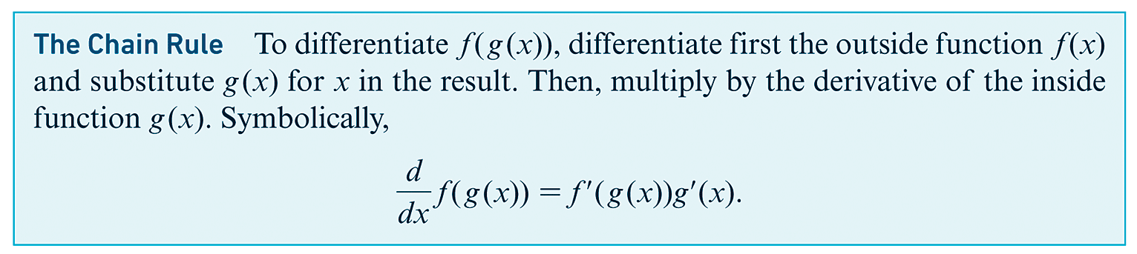
The Chain Rule

Slide 18
The Chain Rule Example 1
EXAMPLE
Use the chain rule to compute the derivative of f (g(x)), where and .
SOLUTION
Finally, by the chain rule,

Slide 19
The Chain Rule Example 2 (1 of 2)
EXAMPLE
Compute using the chain rule.
SOLUTION
Since y is not given directly as a function of x, we cannot compute by
differentiating y directly with respect to x. We can, however, differentiate with respect to u the relation , and get
Similarly, we can differentiate with respect to x the relation and get

Slide 20
The Chain Rule Example 2 (2 of 2)
CONTINUED
Applying the chain rule, we obtain
It is usually desirable to express as a function of x alone, so we substitute 2x² for u to obtain

Slide 21
Marginal Cost & Time Rate of Change (1 of 2)
EXAMPLE
(Marginal Cost and Time Rate of Change) The cost of manufacturing x cases of cereal is C dollars, where . Weekly production at t weeks from the present is estimated to be x = 6200 + 100t cases.
(a) Find the marginal cost,
(b) Find the time rate of change of cost,
(c) How fast (with respect to time) are costs rising when t = 2?
SOLUTION
(a) We differentiate C(x).

Slide 22
Marginal Cost & Time Rate of Change (2 of 2)
CONTINUED
(b) To determine , we use the Chain Rule.
Now we rewrite x in terms of t using x = 6200 + 100t.
(c) With respect to time, when t = 2, costs are rising at a rate of

Slide 23
§ 3.3
Implicit Differentiation and Related Rates

Slide 24
Section Outline
Implicit Differentiation
General Power Rule for Implicit Differentiation
Related Rates

Slide 25
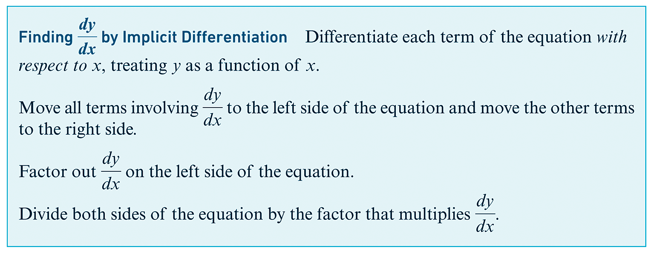
Implicit Differentiation
Here is the general procedure for implicit differentiation:

Slide 26
Implicit Differentiation
EXAMPLE
Use implicit differentiation to determine the slope of the graph at the given point.
SOLUTION
The second term, x², has derivative 2x as usual. We think of the first term, 4y³, as having the form 4[g(x)]³. To differentiate we use the chain rule:
or, equivalently,

Slide 27
Implicit Differentiation
CONTINUED
On the right side of the original equation, the derivative of the constant function -5 is zero. Thus implicit differentiation of yields
Solving for we have
At the point (3, 1) the slope is

Slide 28
Implicit Differentiation
This is the general power rule for implicit differentiation.

Slide 29
Implicit Differentiation
EXAMPLE
Use implicit differentiation to determine
SOLUTION
This is the given equation.
Differentiate.
Eliminate the parentheses.
Differentiate all but the second term.

Slide 30
Implicit Differentiation
CONTINUED
Use the product rule on the second term where f (x) = 4x and g(x) = y.
Differentiate.
Subtract so that the terms not containing dy/dx are on one side.
Factor.
Divide.

Slide 31
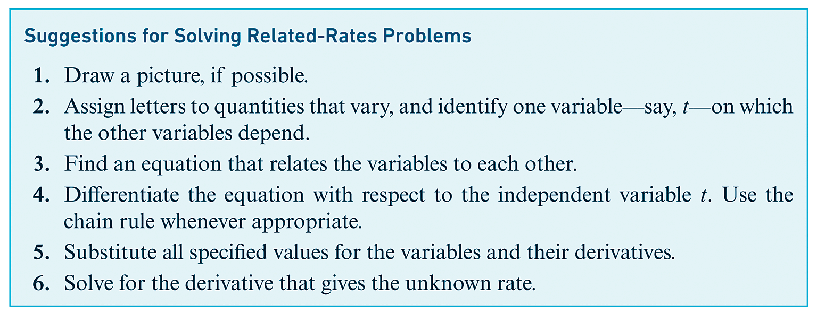
Related Rates

Slide 32
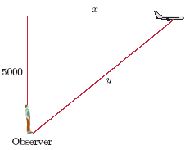
Related Rates
EXAMPLE
(Related Rates) An airplane flying 390 feet per second at an altitude of 5000 feet flew directly over an observer. The figure below shows the relationship of the airplane to the observer at a later time.
(a) Find an equation relating x and y.
(b) Find the value of x when y is 13,000.
(c) How fast is the distance from the observer to the airplane changing at the time when the airplane is 13,000 feet from the observer? That is, what is
at the time when and y = 13,000?

Slide 33
Related Rates
CONTINUED
SOLUTION
(a) To find an equation relating x and y, we notice that x and y are the lengths of two sides of a right triangle. Therefore
(b) To find the value of x when y is 13,000, replace y with 13,000.
This is the function from part (a).
Replace y with 13,000.
Square.
Subtract.

Slide 34
Related Rates
CONTINUED
Take the square root of both sides.
(c) To determine how fast the distance from the observer to the airplane is changing at the time when the airplane is 13,000 feet from the observer, we wish to determine the rate at which y is changing at this time.
This is the function.
Differentiate with respect to t.
Eliminate parentheses.

Slide 35
Related Rates
CONTINUED
y = 13,000; x = 12,000;
Simplify.
Divide.
Therefore, the rate at which the distance from the plane to the observer is changing for the given values is 360 ft/sec.

